Slide 1


APIs and Data Storage in MATLAB

Slide 2

Gathering and Organizing Data
In the previous lesson, we learned that machine learning models require data to make predictions and inferences.
Exercises in lesson 2 required the user to import the data manually into MATLAB®; however, this method becomes increasingly inefficient when dealing with large amounts of data.
Get into groups and let's discuss the following questions:
How do data scientists gather large amounts of data?
How do you think that apps on your smartphone get data?
Why must data be organized and sorted?
Relate your answers to your experiences.
Hint: Think about the apps used in your daily life and how those apps are organized. For example, Spotify allows the user to sort through music according to genre, artist, and popularity.

Slide 3
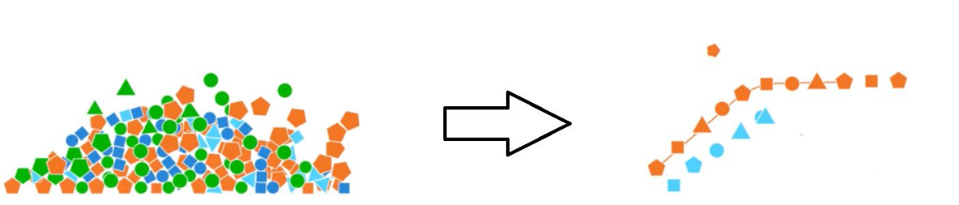
Gathering and Organizing Data
After discussing the questions let’s introduce some key concepts for this lesson.
Data scientists obtain large amounts of data from various sources using a combination of techniques and tools. Some of the most common ways include application programming interfaces (APIs) and Web scraping. The focus of this lesson will be APIs.
APIs are mechanisms that enable 2 software components to communicate with each other using a set of definitions and protocols. One application of APIs is weather apps. The app (client) communicates with a weather database (server) via APIs to provide the user with weather updates.

Slide 4
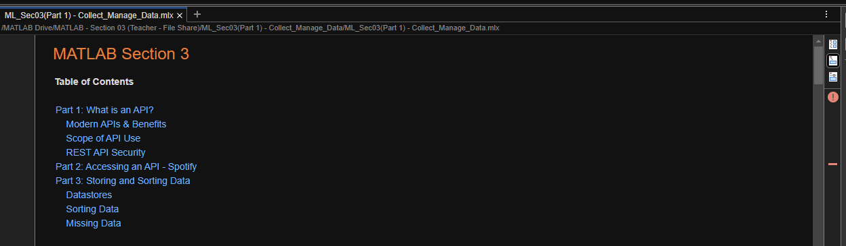
Collecting and Managing Data
Please copy over the files for Section 03 from the MATLAB Drive
The MATLAB files for this section can be found at this link.
Notes:
The URL on this slide is for the student version of the files, please see the teacher guide for the teacher version of the files You can also find the teacher and student links on the master document with all the youtube video and matlab drive links for every section on it

Slide 5



Collecting and Managing Data
What is an API?
In the beginning of this lesson, APIs are described as mechanisms that allow 2 software components to communicate with each other using a set of definitions and protocols.
A useful metaphor to understand APIs is thinking of them as a messenger, like how a waiter communicates your order to the kitchen.
Applications of APIs in daily life include ride-share apps, airline websites, and apps that allow you to control devices, like a thermostat. All of these apps send data to a server so that it can perform a series of actions to fulfill your request.

Slide 6
Collecting and Managing Data
Modern APIs & Benefits
The most widely used and flexible APIs are known as Representational State Transfer (REST) APIs. In REST APIs, a server uses input from the client to perform internal functions and return output data. Data is encoded and transported between the clients and servers using Hypertext Transfer Protocol (HTTP).
The main benefits of REST APIs are integration and ease of maintenance. REST APIs allow existing software systems to be integrated to new applications without having to make changes to the code of the two systems. Another important feature of APIs are endpoints. API endpoints include server URLs, services, and other digital locations from where information is sent and received between systems

Slide 7



Collecting and Managing Data
Scope of API Use
Private API: Used only for connecting systems and transporting data within a single business.
Public API: Open to the public but may have some authorization restrictions associated with them.
Partner API: Available only to authorized developers to facilitate business-to-business partnerships.
Composite API: A combination of two or more of the types above to meet complex system requirements.

Slide 8



Collecting and Managing Data
REST API Security
REST APIs are secured using authentication tokens and API keys. Authentication tokens authorize users to make a specific API call and verify the user's identity before processing an API call.
API keys verify the program or app making the API call to ensure it has the permission to make a specific call. API keys allow API monitoring to gather data on usage. API keys appear in browser URLs as a long string of characters and numbers and are used by the website to make internal API calls.

Slide 9
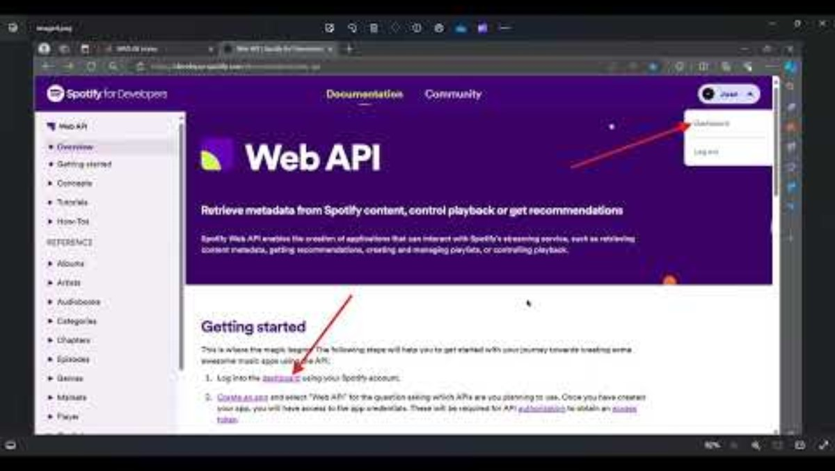
Creating a Spotify Developer Account for the API
In this section, we will be accessing the Spotify API to gather music data. Please watch the video below to make an account.
The MATLAB files for this section can be found at this link.
Notes:
The URL on this slide is for the student version of the files, please see the teacher guide for the teacher version of the files You can also find the teacher and student links on the master document with all the youtube video and matlab drive links for every section on it

Slide 10

Creating a Spotify Developer Account for the API
The steps below are also described in video on the previous slide
Follow this link to the Spotify Developer website: Web API | Spotify for Developers
Log in with an existing Spotify account or create account.
Go to developer Dashboard to and click on Create app.
Input a name and description for your app.
Create a URI using the following format: http://localhost:8081. Any combination of numbers is valid. Click the Add button.
Check the boxes for Web API and the Terms of Service. Click the Save button.
Go to the app's Settings to retrieve your unique Client ID and Client Secret. You will use these to run the code in the MATLAB files provided.
Notes:
The URL on this slide is for the student version of the files, please see the teacher guide for the teacher version of the files You can also find the teacher and student links on the master document with all the youtube video and matlab drive links for every section on it

Slide 11
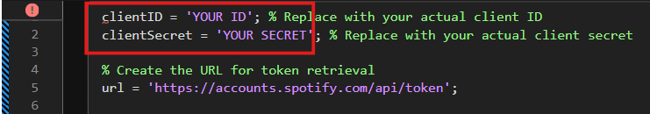
Collecting and Managing Data
Accessing an API - Spotify
The functionalities of the Spotify Web API include:
Retrieving data from an artists, albums, or shows
Searching for Spotify content
Getting recommendations based on the music you listen to
To access the API, you need get an access token using your Client ID and Client Secret.

Slide 12
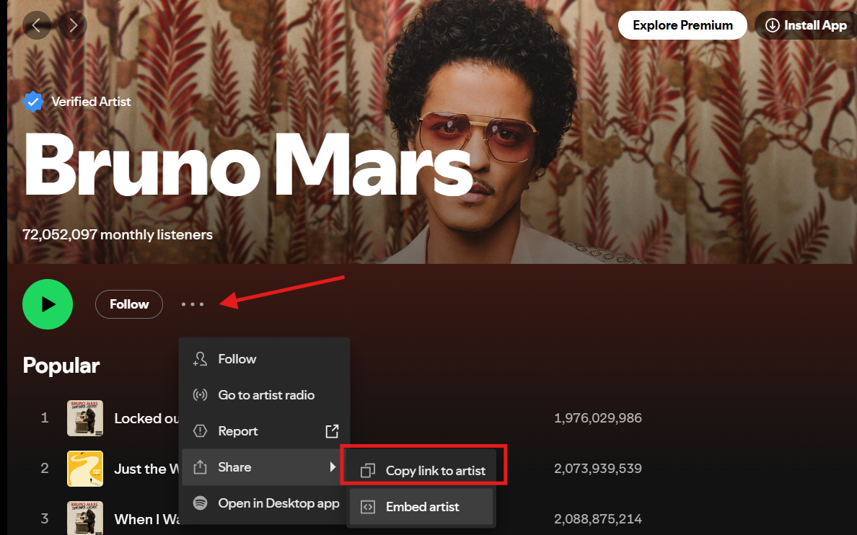
Collecting and Managing Data
Accessing an API - Spotify
Now that we have an access token we can start retrieving data. In this example we will retrieve data from four Artists: Kendrick Lamar, Drake, Taylor Swift, and Billie Eilish.
First, we need to construct the URL for each of their Spotify profiles using their Spotify IDs. The Spotify ID is a unique string of characters used to identify an artist on Spotify.
Here's how to find it:
Go to the Artist's Page on Spotify and click on the 3 horizontal dots below the artist's name.
Select Share from the menu and click Copy link to artist.
Paste this link into a browser.
The Spotify ID is the string of characters located between /artist/ and the ?

Slide 13
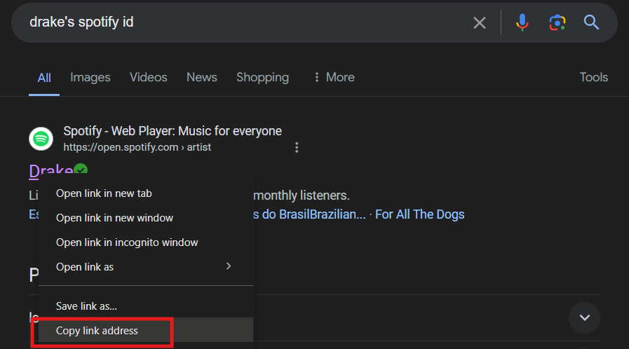
Collecting and Managing Data
Accessing an API - Spotify
If you don't have access to Spotify you can instead Google search the artist's ID and right click to copy the link address to their Spotify page. Paste their link into the MATLAB live script and delete everything except their Spotify ID.
Here is the link to Drake's Spotify page, which includes his Spotify ID in bold at the end of the link: https://open.spotify.com/artist/3TVXtAsR1Inumwj472S9r4

Slide 14


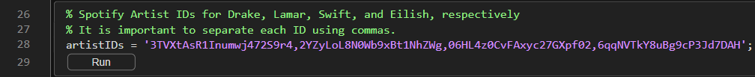
Collecting and Managing Data
Accessing an API - Spotify
Once we have all Spotify IDs, we need to store them as a comma-separated list and assign them to a variable. According to Spotify, you can access the profiles of a maximum 100 artists at once. Run the code snippet below to store the IDs into the variable artistIDs.
"Drake July 2016" by The Come Up Show is licensed under CC BY 2.5.

Slide 15
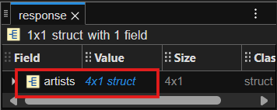
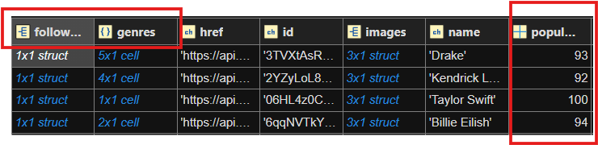
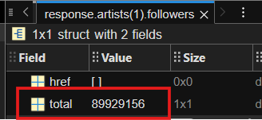
Collecting and Managing Data
Accessing an API - Spotify
To see what data was retrieved, we can click on the variable "response" in the workspace. Then click "artists.
Below is the data retrieved. Here we can see the artists’ popularity indices, which is a number out of 100 that Spotify uses to rank artists. There is also information about their followers and genres of their songs.
Click on the 1x1 struct under "followers" to see the number of followers an artists has.

Slide 16
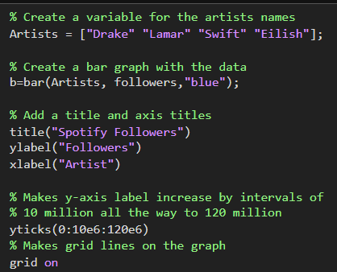
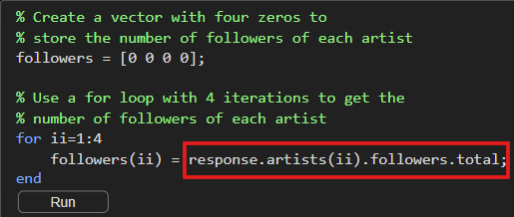
Collecting and Managing Data
Accessing an API - Spotify
Let's use the data to create a bar graph showing how many followers each artists has on Spotify with the code below. We will be using a for loop and dot notation to retrieve the number of followers for each artists from the variable response.
Now let's run the code to make the bar graph. The resulting graph is shown in the next slide.

Slide 17
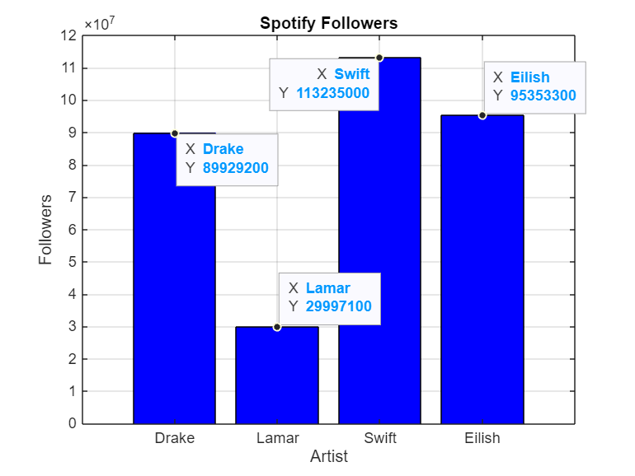
Collecting and Managing Data
Accessing an API - Spotify
The y-axis on the bar graph shows the number of followers in the magnitude of millions.
Taylor Swift: 113,235,000
Billie Eilish: 95,353,300
Drake: 89,929,200
Kendrick Lamar: 29,997,100
You can click on the graph to add labels to each bar.

Slide 18
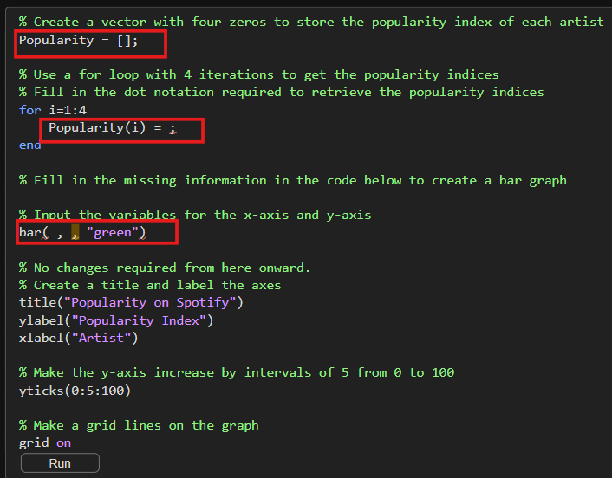
Collecting and Managing Data
Accessing an API - Spotify
Now you try!
Fill in the missing code in the red boxes to create a bar graph comparing the popularity index of each artist.
Hint: Use a for a loop and the dot notation: response.artists(i).popularity to retrieve the data needed. Refer to the code on slide 16 for assistance.

Slide 19

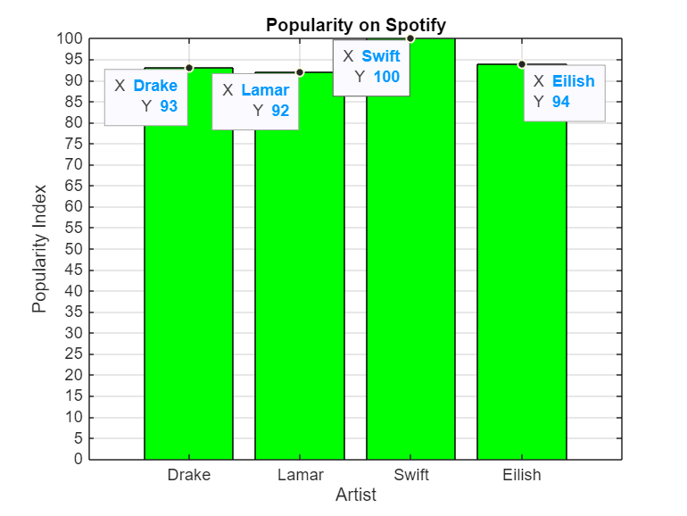
Collecting and Managing Data
Discussion
Compare the graphs you just made. What do the graphs reveal about the artists? Is their popularity directly related to the number followers they have? How would these results affect decision making when designing an AI model to find out go is the next GOAT?

Slide 20
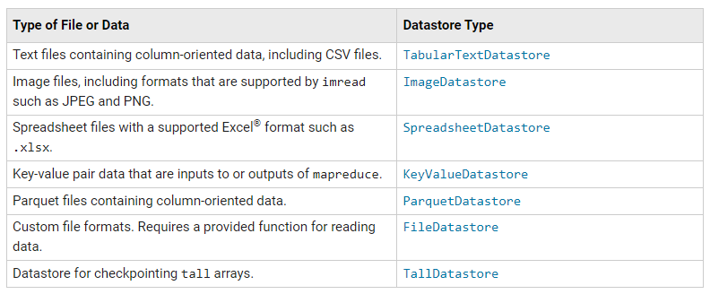
Collecting and Managing Data
Datastores
Now that we can access large amounts of data from an API, we need to store it properly. In the following example, we will reuse the Formula 1 files from section 2 to demonstrate how to create a datastore in MATLAB.
A datastore provides a convenient way to access data stored in multiple files. The benefit of a datastore is that it allows you to manage a large collection of files that would otherwise be too large to fit in the system's memory. The table below shows the functions required to make a specific datastore type.

Slide 21
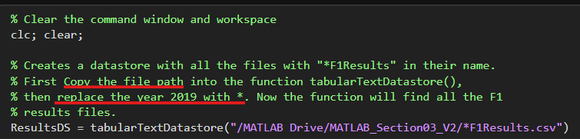
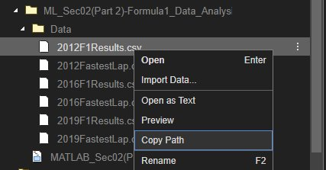
Collecting and Managing Data
Datastores
This code searches for files with the words "F1Results.csv" in their name using the function tabularTextDatastore(). To facilitate the creation of the datastore we can put all the files in the same folder as this live script. However, this is not required since we can specify the location of the files within the function.
Recommendation: Use "copy path" by right clicking on the file to get the .csv path for the tabularTextDatastore() function

Slide 22
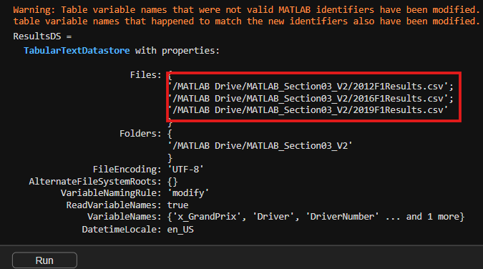
Collecting and Managing Data
Datastores
By examining the output of the code on the previous slide, we can see that 3 files containing F1 results have been stored in the datastore.
Note: Disregard the Warning message.

Slide 23
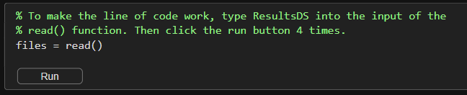
Collecting and Managing Data
Datastores
Now you try!
To access the files store in the newly created datastore, you can use the read() function. This function will call each file in the datastore one at a time. The first time you use read(), data from the first file is imported. Using it a second imports data from the second file, and so on.
Click the run button 3 times to see how the data table changes. What happens when you click the run button a 4th time?

Slide 24
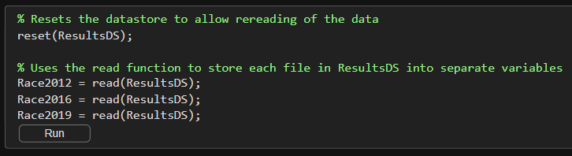
Collecting and Managing Data
Datastores
Before continuing, let's reset the datastore using reset() and use read() 3 times to store each file in the datastore into its own variable.

Slide 25
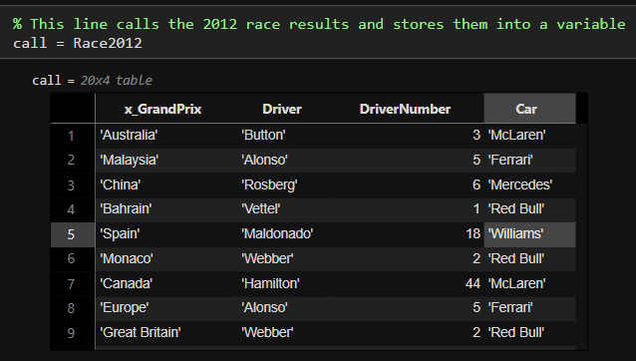
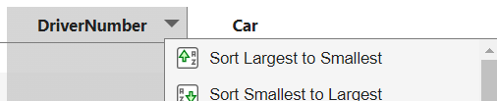
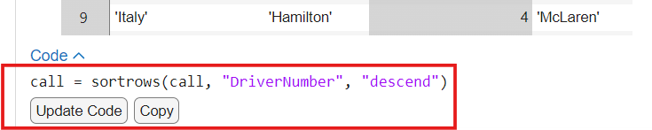
Collecting and Managing Data
Sorting Data
Let’s use some of the F1 data to explore two functionalities of data tables in MATLAB: sorting data and adding data to a table. Being able to quickly sort data is very helpful when providing data to an AI model. For this example, we will first call the 2012 race results and then sort the driver number column from least to greatest.
Hover over the headings of each column until a dropdown arrow appears. This arrow allows you to sort the data from smallest to largest or vice versa.
Notice that after selecting one of these options, MATLAB will provide the code necessary to implement these changes into the live script.

Slide 26
Collecting and Managing Data
Sorting Data
Now you try!
Go to the 2012 data table and follow the steps in the pervious slide to sort the DriverNumber column.
Then click "Update Code" or "Copy" to incorporate the suggested code to the live script and rerun this section.
When you sorted the DriverNumber column, did the other columns also change?

Slide 27
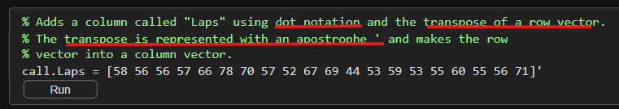
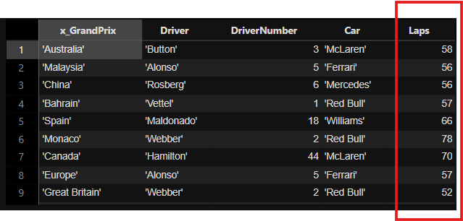
Collecting and Managing Data
Sorting Data
Another important feature is the ability to add columns to an existing data table. Adding columns to a table can be a useful way of storing the results of calculations performed on a dataset.
The code on the right adds an extra column of data to the 2012 race results using dot notation. The additional column will contain the number of laps in a race
Output

Slide 28

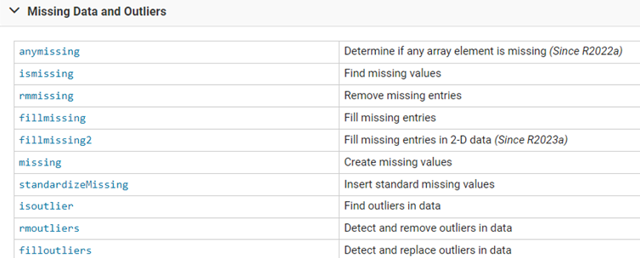

Collecting and Managing Data
Missing Data
Finally, let's review what can be done when the data you have has missing values. When files with missing values are imported into MATLAB, the missing data is often replaced with NaN (Not a Number). Any calculations involving NaN will result in a value of NaN and can create misleading computations.
The image above shows some functions that are commonly used to deal with missing data values.

Slide 29
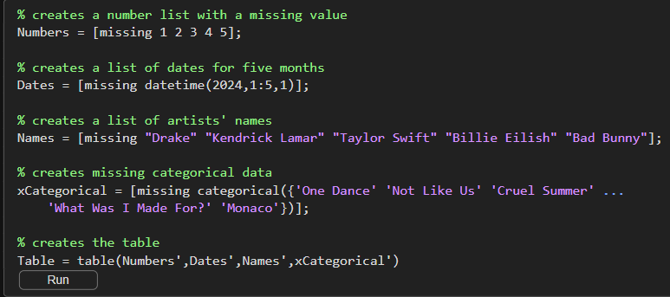
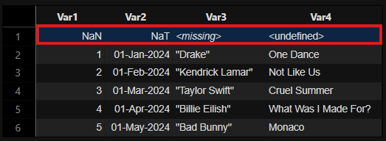
Collecting and Managing Data
Missing Data
To show how two of these functions work, first let’s create a data table of imaginary release dates from five artists by running the code below. The data table will purposefully contain missing information.

Slide 30
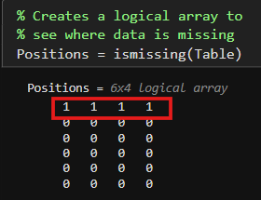
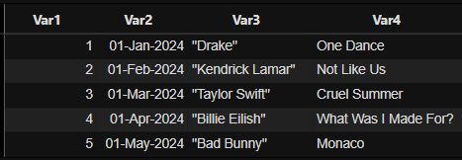
Collecting and Managing Data
Missing Data
We can use ismissing() to find where data is missing in the table. The function will output a logical array with ones in the positions where data is missing.
Note: This is very helpful because you do not have to go row by row to find where data is missing. Knowing the location of missing data is the first step in cleaning your data.
With the function rmmissing() we can remove all missing data types. The benefit of this function is that it works with any kind of data type.
Note: The function works perfectly in this example because all the missing data is in the same row. However, missing data is not always in the same row, so instead we would end up with random blank spaces throughout the table.

Slide 31
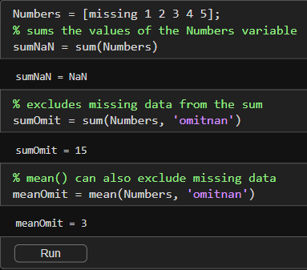
Collecting and Managing Data
Missing Data
Finally, it is important to note that many MATLAB functions enable you to ignore missing values, without having to explicitly locate, fill, or remove them first.
For example, if you compute the sum of a vector containing NaN values, the result is NaN. However, you can directly ignore NaNs in the sum by using the 'omitnan' option with the sum function.

Slide 32
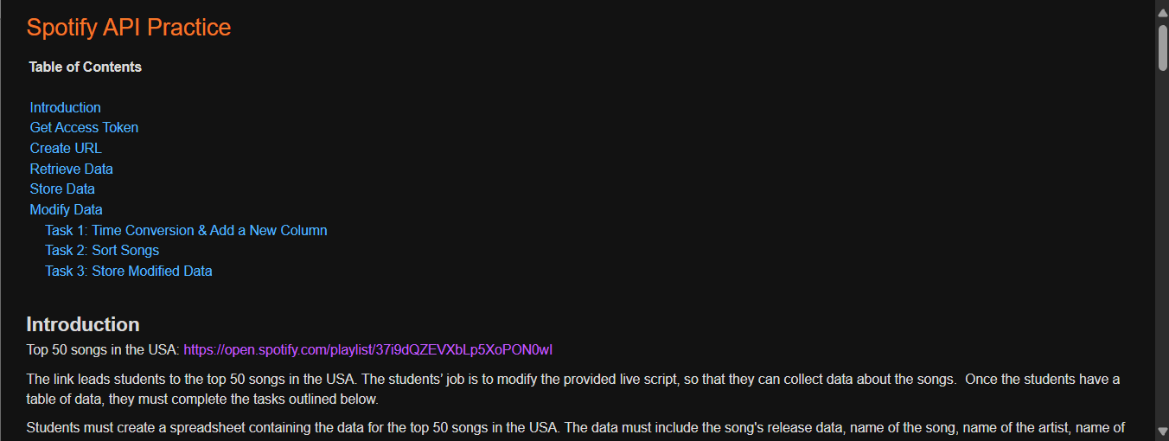
Practicing with the Spotify API
Please copy over the files for Section 03 from the MATLAB Drive, the Part 2 live script should be in the same folder.
The MATLAB files for this section can be found at this link.
Notes:
The URL on this slide is for the student version of the files, please see the teacher guide for the teacher version of the files You can also find the teacher and student links on the master document with all the youtube video and matlab drive links for every section on it

Slide 33


Spotify API Practice
Introduction
You’ve been tasked by a record label to collect Spotify data on the Top 50 Songs in the USA. Your job is to create a spreadsheet containing the release data, name of the song, name of the artist, name of the album, and the duration of the Top 50 songs. After making the spreadsheet you need to complete the tasks below.
Task 1: Convert the Duration into minutes and add the results into a new column in the data table.
Task 2: Without using code sort the songs in order of longest to shortest duration.
Task 3: Store the modified data table into a new Excel file.
You will need an account to access the API, as you did in the previous live script, feel free to go back to this video if needed.

Slide 34
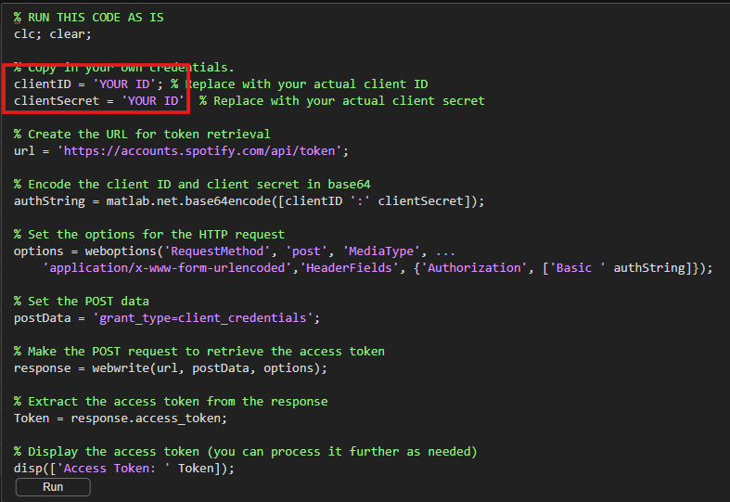
Spotify API Practice
Get Access Token
Remember that first we need to get an Access Token. Copy your Client ID and Client Secret in the code below to get a token.

Slide 35
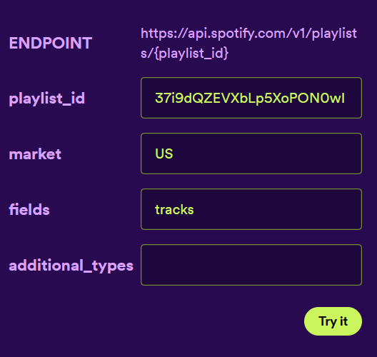
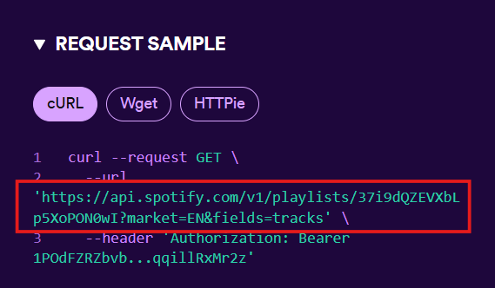
Spotify API Practice
Create the URL
Use the interactive feature to create the appropriate link to access the playlist. In the Market text box type "US" and in the Field text box type “tracks".
The Request Sample will display the URL you need to use. This makes it really easy to access all kinds of data from the Spotify API.
This URL has already been included in your code, but it has some missing information. On the next slide, are instructions to fill in the missing information to format the variable "url" correctly.

Slide 36
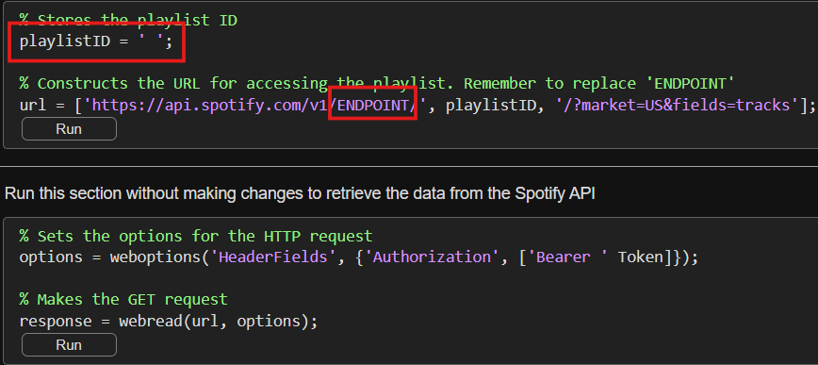
Spotify API Practice
Create the URL
Fill in the missing information in the red boxes to format the variable "url" correctly.
Copy in the playlistID. Hint: The link to the playlist (Slide 33) provides some of the information required by the API. From the link we know that the playlist ID is '37i9dQZEVXbLp5XoPON0wI’.
Replace /ENDPOINT/ with the endpoint required to access playlists. Hint: Examine the link in the Request Sample screenshot on the previous slide.

Slide 37
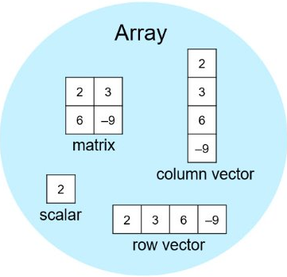
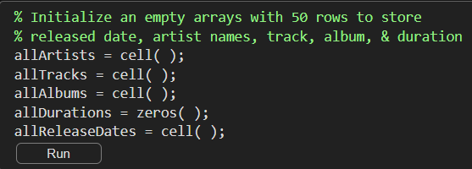
Spotify API Practice
Retrieve Data
Now you need to extract the release date, name of the artist, track, album, and the duration of the tracks from the variable "response".
First create empty arrays to store the data. Fill in the empty cell() and zeros() functions to create arrays with 1 column and 50 rows.

Slide 38
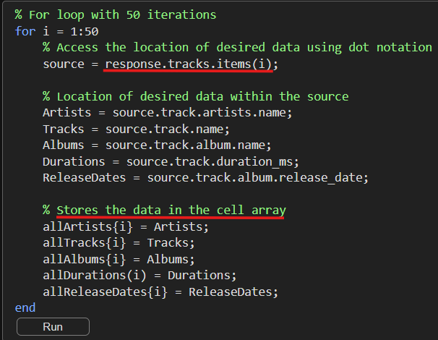
Spotify API Practice
Retrieve Data
If you look at the data stored in the “response” variable, you will notice that most of the desired data is stored in a 50 individual structures called "items". To access "items" use the dot notation response.tracks.items(i). The for loop below goes through each "items" structure to extract the desired data for each song. Run the code segment below without making any changes.
For this example, the location of the data has been provided, but it is recommended that you open the "response" variable by clicking on it in the workspace to see how the data is stored within the variable.

Slide 39
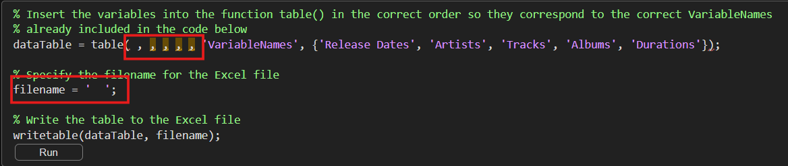
Spotify API Practice
Store Data
To store the retrieved data in an Excel file:
Input the name of the 5 variables with data into the table() function in the correct order Hint: The order is determined is given between {}. The variables you need to input the table function are allArtists, allTracks, allAlbums, allDurations, allReleaseDates.
Name the Excel file before running this segment of code for it to work.

Slide 40
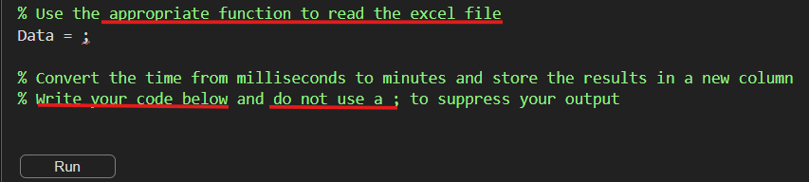
Spotify API Practice
Task 1: Time Conversion & Add a New Column
Now you have an Excel file to complete the required tasks. For the first task write code to store the data into variable called Data. Then convert the duration of each song into minutes and store the results in a new column called "ConvertedDurations".
Hint 1: Refer to Slide 27 for help.
Hint 2: 60,000 seconds = 1 minute
Note: Disregard the Warning message that appears when you run the code.

Slide 41
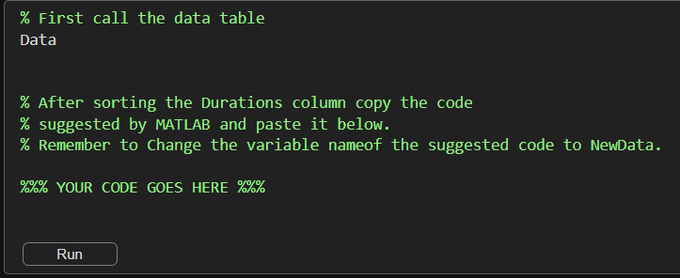
Spotify API Practice
Task 2: Sort the Songs
Call the data table and sort the duration from longest to shortest without using code. Then copy the code that MATLAB suggests to modify the data table. Finally, store the new table in the variable “NewData”.
Hint: Refer to Slide 25 for help.

Slide 42
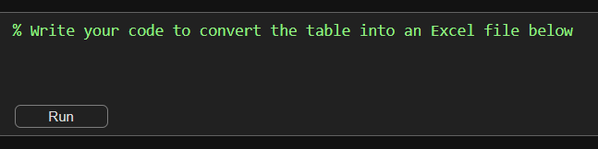
Spotify API Practice
Task 3: Store Modified Data
Write a single line of code to store the table "NewData" into a new excel file with the name "Top_50_USA_v2"
Hint: See the Store Data section on Slide 39 to identify which function is used to create an Excel file.

Slide 43
What are the Benefits of APIs?
Congratulations, you have completed your task for the record label!
Now Let's think about the lesson and activity we just did:
In this lesson, we learned about APIs and practiced retrieving data from the Spotify API. We also learned how to create datastores and sort data in MATLAB®.
Knowing this, discuss the following in groups:
Discuss the benefits of using an API to retrieve data versus directly uploading files with data into MATLAB®.
Reflect on any challenges faced when working with the Spotify API in the practice activity.

Slide 44
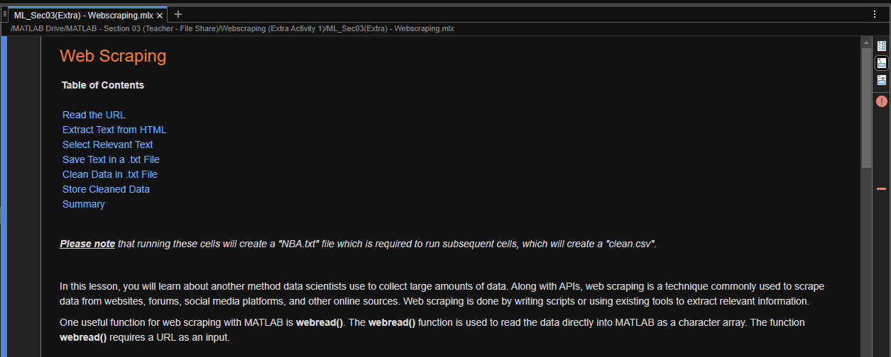
EXTRA Practice/Reference Material: Web Scraping
Please copy over the files for Section 03 from the MATLAB Drive, the “Extra 1” live script should be in the same folder.
The MATLAB files for this section can be found at this link.
Notes:
The URL on this slide is for the student version of the files, please see the teacher guide for the teacher version of the files You can also find the teacher and student links on the master document with all the youtube video and matlab drive links for every section on it

Slide 45
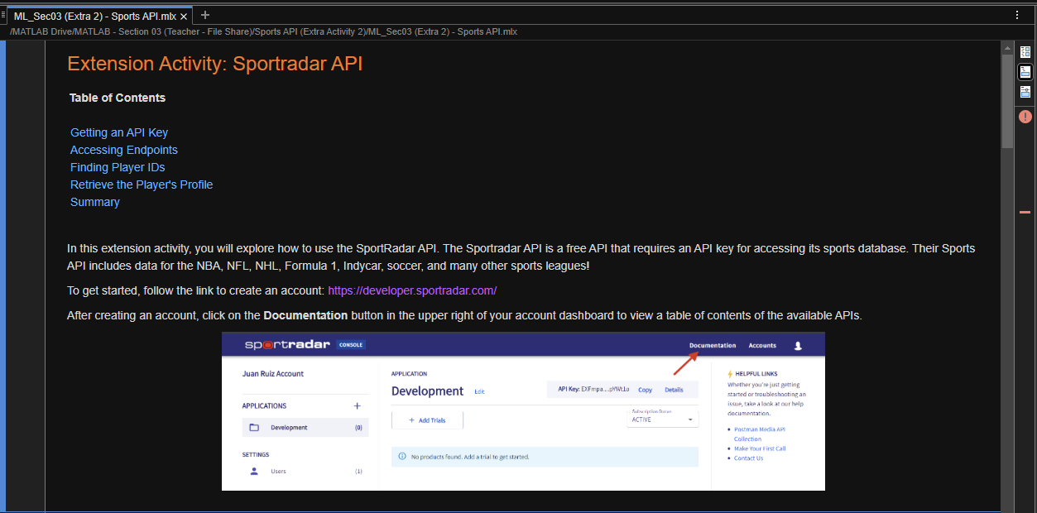
EXTRA Practice/Reference Material: Sports API
Please copy over the files for Section 03 from the MATLAB Drive, the “Extra 2” live script should be in the same folder.
The MATLAB files for this section can be found at this link.
Notes:
The URL on this slide is for the student version of the files, please see the teacher guide for the teacher version of the files You can also find the teacher and student links on the master document with all the youtube video and matlab drive links for every section on it

